Slide 1
Continuous Random Variable
Ansar Shahzadi
School of Electrical Engineering & Computer Science
National University of Science and Technology(NUST)

Slide 2
Continuous random variables
A continuous random variable can assume any value along a given interval of a number line.
Examples:
Depth
Volume
Time
Weight
Length

Slide 3
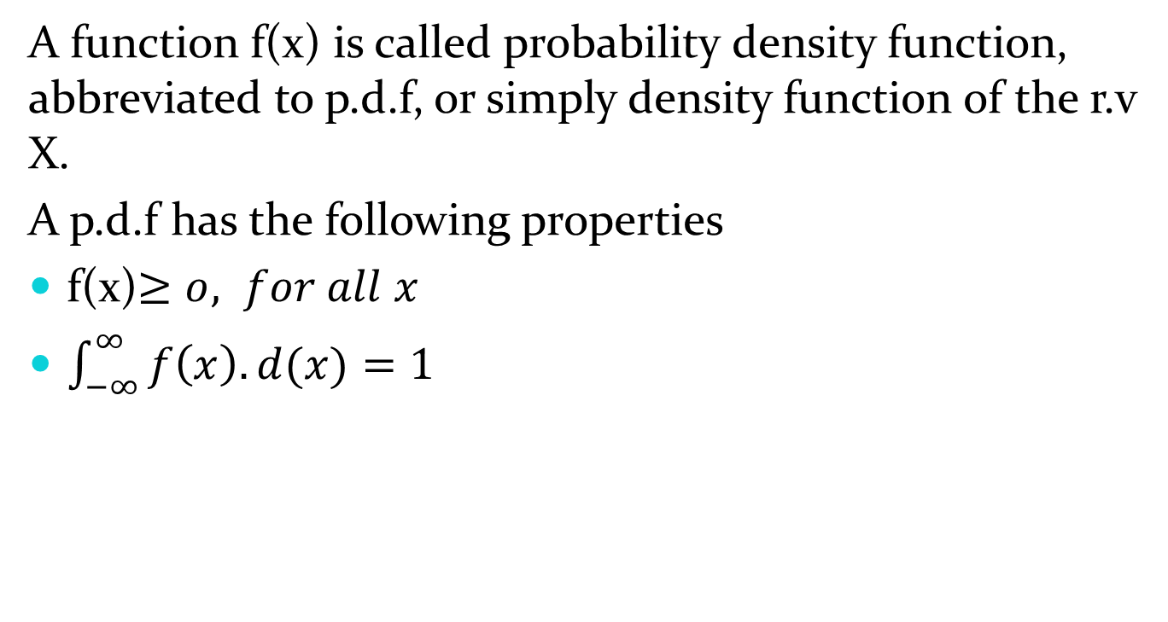
Probability Density function
A function f(x) is called probability density function, abbreviated to p.d.f, or simply density function of the r.v X.
A p.d.f has the following properties
f(x)$≥o, for all x$
$\int_{−∞}^{∞}{f\left(x\right).d(x)=1}$

Slide 4
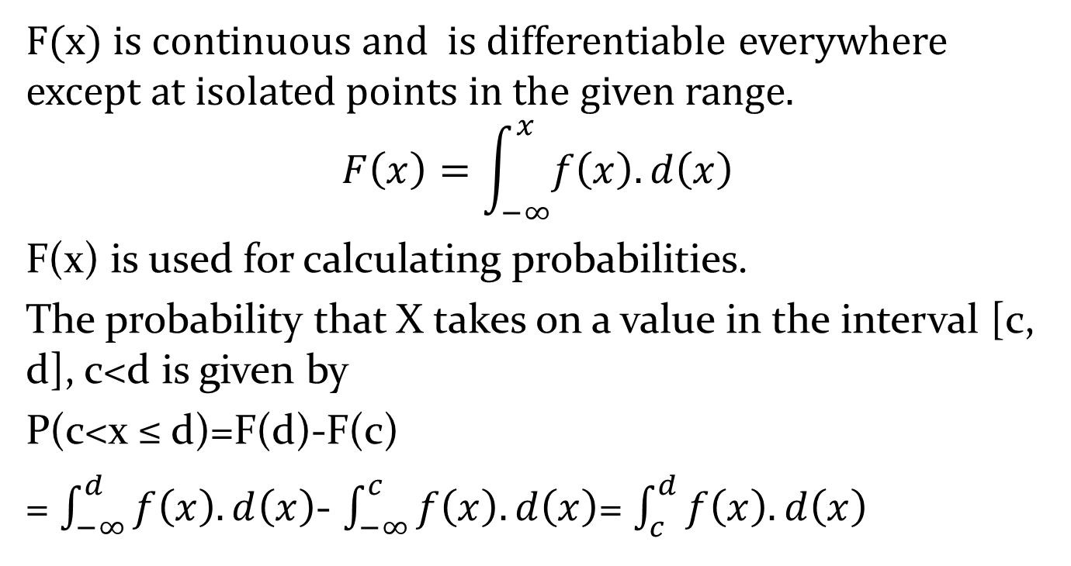
Distribution Function
F(x) is continuous and is differentiable everywhere except at isolated points in the given range.
$$F\left(x\right)=\int_{−∞}^{x}{f\left(x\right).d\left(x\right)}$$
F(x) is used for calculating probabilities.
The probability that X takes on a value in the interval [c, d], c<d is given by
P(c<x ≤ d)=F(d)-F(c)
= $\int_{−∞}^{d}{f\left(x\right).d\left(x\right)}$- $\int_{−∞}^{c}{f\left(x\right).d\left(x\right)}$= $\int_{c}^{d}{f\left(x\right).d\left(x\right)}$

Slide 5
Example: Uniform Distribution
The uniform distribution is a continuous distribution in which the same height, of f(X), is obtained over a range of values.
Area = 1
a
b

Slide 6
Uniform Distribution
The cumulative distribution function of the uniform random variable X is given by
For any x such that -∞<x≤
For any x such that
For

Slide 7
Question: Uniform Distribution
The arrival time of a student in a class is uniformly distributed with first 10 minutes. Find the probabilities that
the student arrive within first 5 minutes.
the student arrive after 6 minutes.
the student arrive between 2 to 7 minutes.
the student arrive after 15 minutes.

Slide 8
Solution
The p.d.f of X is
The Cumulative distribution function of X is

Slide 9
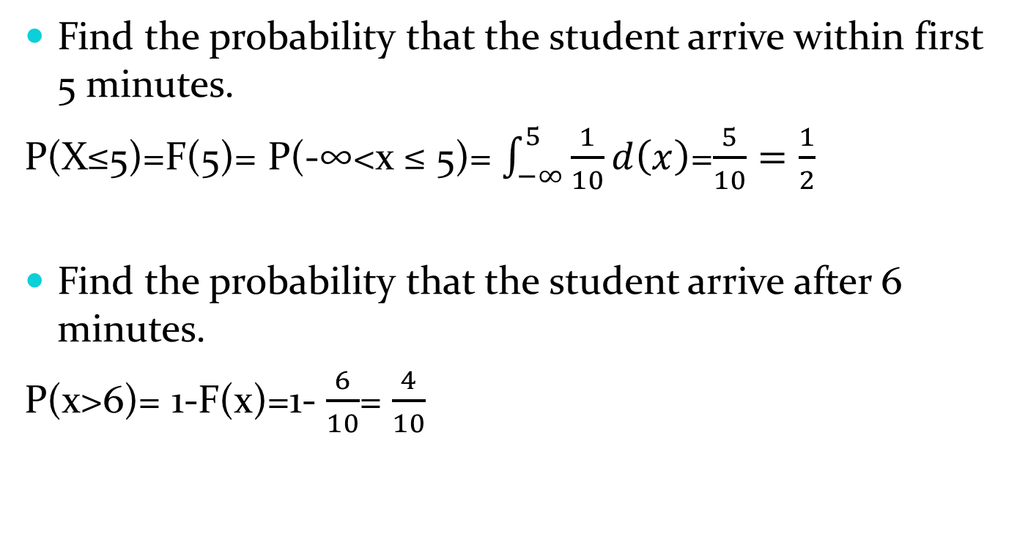
Solution
Find the probability that the student arrive within first 5 minutes.
P(X≤5)=F(5)= P(-∞<x ≤ 5)= $\int_{−∞}^{5}{\frac{1}{10}d\left(x\right)}$=$\frac{5}{10}=\frac{1}{2}$
Find the probability that the student arrive after 6 minutes.
P(x>6)= 1-F(x)=1- $\frac{6}{10}$= $\frac{4}{10}$

Slide 10
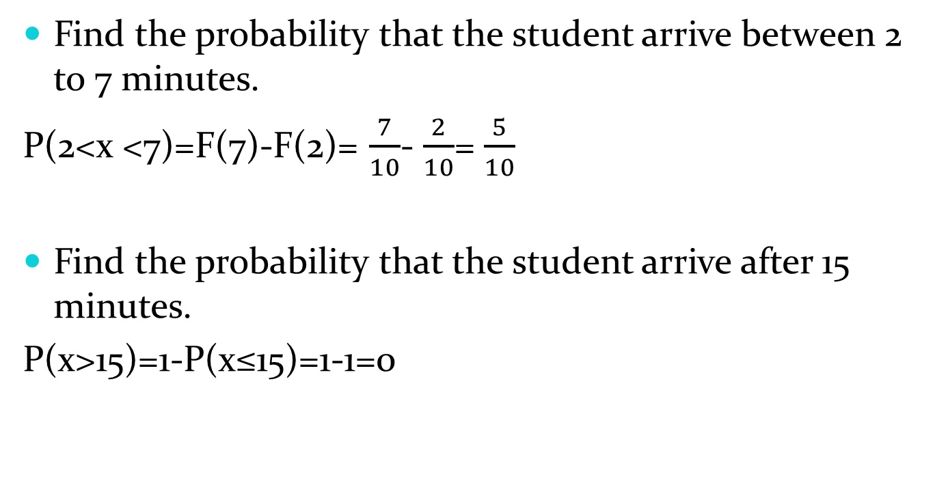
Solution
Find the probability that the student arrive between 2 to 7 minutes.
P(2<x <7)=F(7)-F(2)= $\frac{7}{10}$- $\frac{2}{10}$= $\frac{5}{10}$
Find the probability that the student arrive after 15 minutes.
P(x>15)=1-P(x≤15)=1-1=0

Slide 11
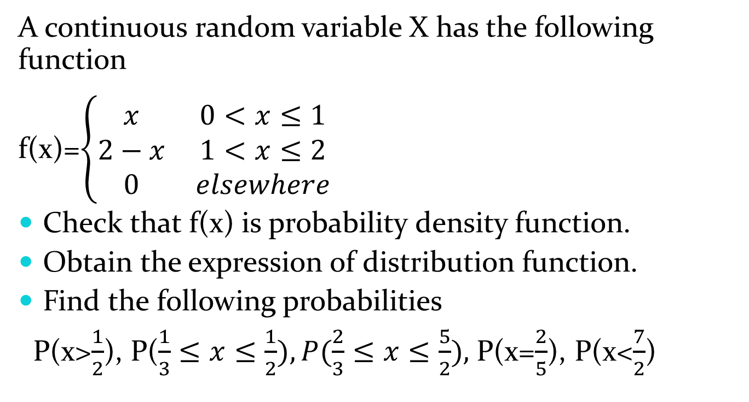
Question
A continuous random variable X has the following function
f(x)=$\left\{\begin{matrix}x & 0<x≤1 \\ 2−x & 1<x≤2 \\ 0 & elsewhere\end{matrix}\right.$
Check that f(x) is probability density function.
Obtain the expression of distribution function.
Find the following probabilities
P(x>$\frac{1}{2}$), P($\frac{1}{3}≤x≤\frac{1}{2}), P(\frac{2}{3}≤x≤\frac{5}{2}),$P(x=$\frac{2}{5}$), P(x<$\frac{7}{2}$)

Slide 12
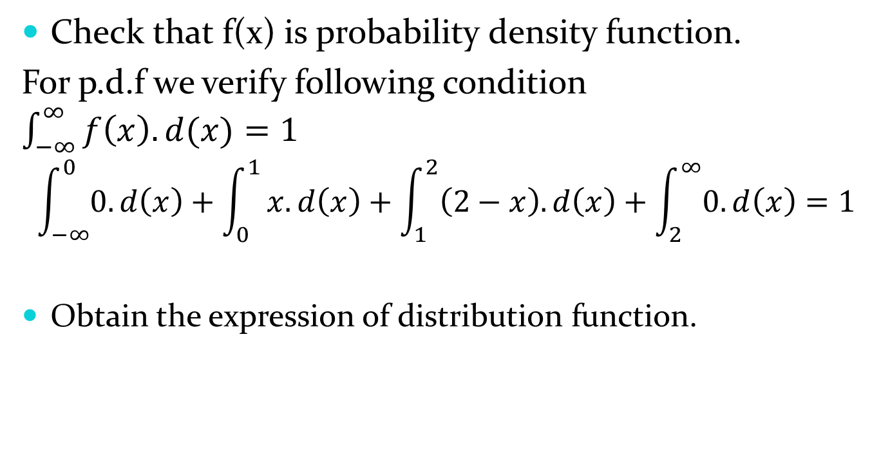
Solution
Check that f(x) is probability density function.
For p.d.f we verify following condition $\int_{−∞}^{∞}{f\left(x\right).d(x)=1}$
$$\int_{−∞}^{0}{0.d\left(x\right)}+\int_{0}^{1}{x.d\left(x\right)+\int_{1}^{2}{\left(2−x\right).d\left(x\right)+\int_{2}^{∞}{0.d\left(x\right)=1}}}$$
Obtain the expression of distribution function.

Slide 13
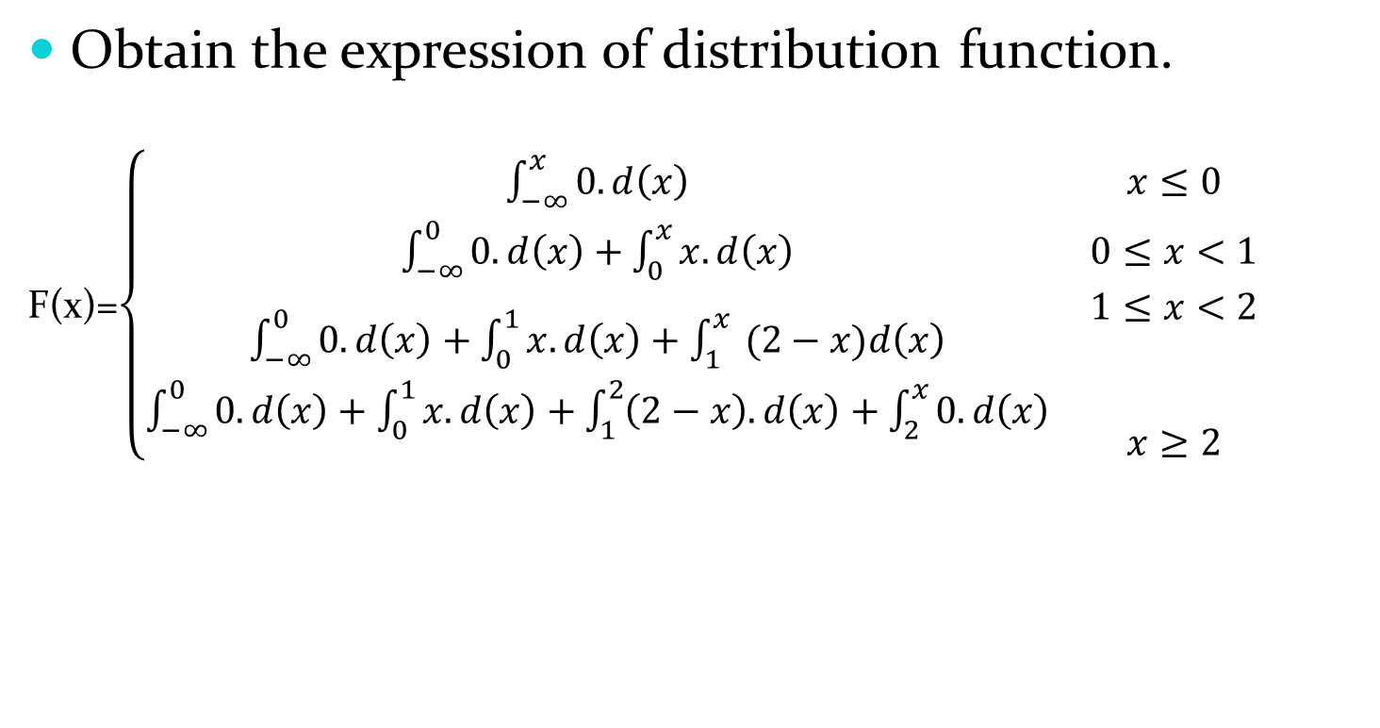
Solution
Obtain the expression of distribution function.
F(x)=$\left\{\begin{matrix}\int_{−∞}^{x}{0.d\left(x\right)} & x≤0 \\ \int_{−∞}^{0}{0.d\left(x\right)}+\int_{0}^{x}{x.d\left(x\right)} & 0≤x<1 \\ \begin{matrix}\int_{−∞}^{0}{0.d\left(x\right)}+\int_{0}^{1}{x.d\left(x\right)}+\int_{1}^{x}{ (2−x)d\left(x\right)} \\ \int_{−∞}^{0}{0.d\left(x\right)}+\int_{0}^{1}{x.d\left(x\right)}+\int_{1}^{2}{\left(2−x\right).d\left(x\right)}+\int_{2}^{x}{0.d\left(x\right)}\end{matrix} & \begin{matrix}\begin{matrix}1≤x<2 \\ \end{matrix} \\ \begin{matrix} \\ x≥2\end{matrix}\end{matrix}\end{matrix}\right.$

Slide 14
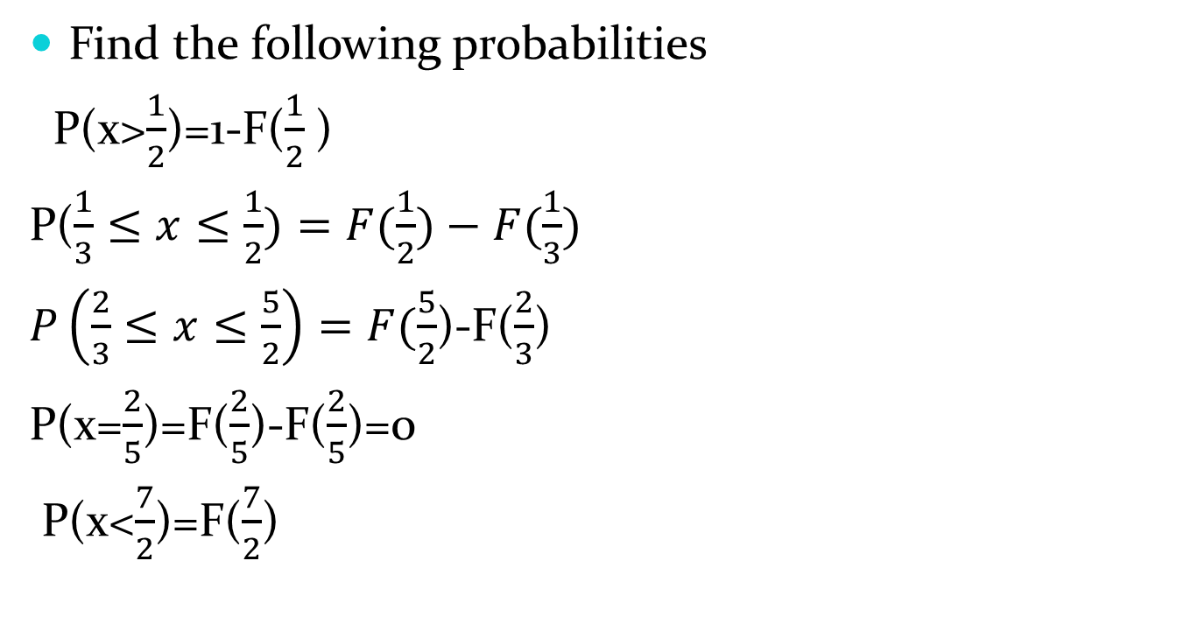
Solution
Find the following probabilities
P(x>$\frac{1}{2}$)=1-F($\frac{1}{2}$)
P($\frac{1}{3}≤x≤\frac{1}{2})=F(\frac{1}{2})−F(\frac{1}{3})$
$P\left(\frac{2}{3}≤x≤\frac{5}{2}\right)=F(\frac{5}{2}$)-F($\frac{2}{3}$)
P(x=$\frac{2}{5}$)=F($\frac{2}{5}$)-F($\frac{2}{5}$)=0
P(x<$\frac{7}{2}$)=F($\frac{7}{2}$)

Slide 15
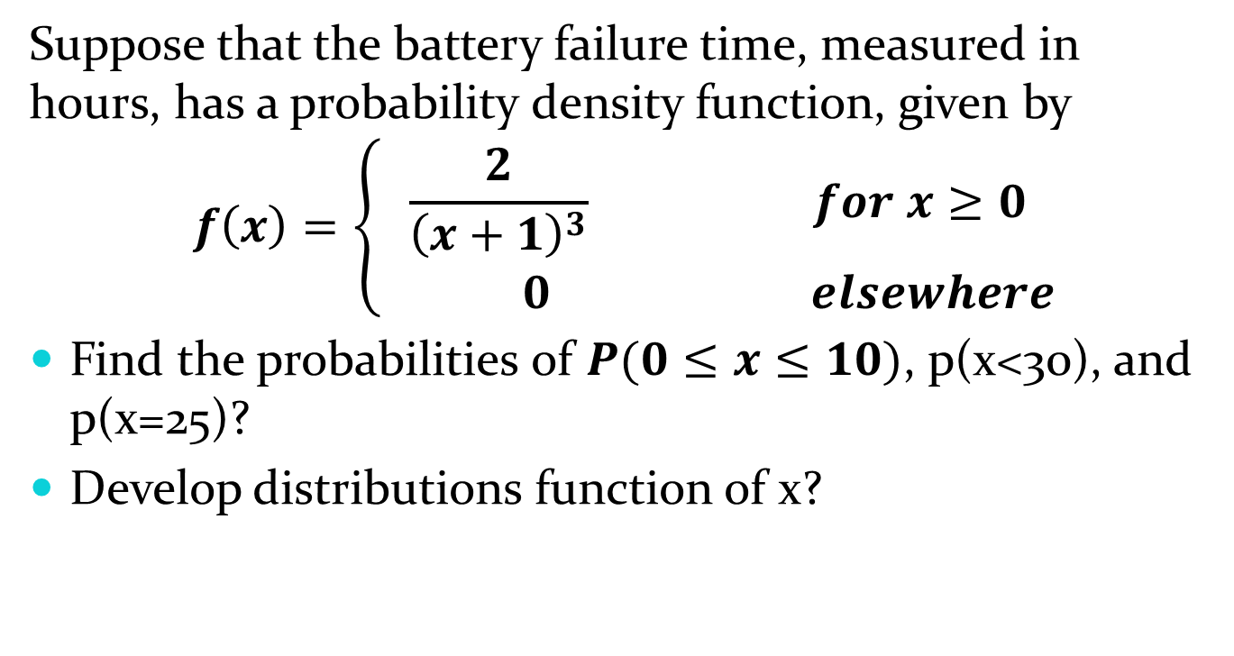
Question
Suppose that the battery failure time, measured in hours, has a probability density function, given by
$$f\left(x\right)=\left\{\begin{matrix}\frac{2}{{\left(x+1\right)}^{3}} for x≥0 \\ 0 elsewhere\end{matrix}\right.$$
Find the probabilities of $P(0≤x≤10)$, p(x<30), and p(x=25)?
Develop distributions function of x?

